Slide 1

GROUP-8

Slide 2



CAMPAIGN
TALKS
REFERRAL PROGRAMS
PAMPHLET

Slide 3


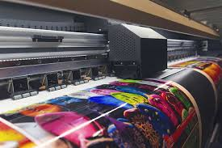
ADVERTISEMENT
BANNERS
WEBSITE ADS
SOCIAL MEDIA ADS

Slide 4


ONLINE PROMOTIONS
SOCIAL MEDIA PLATFORM
RUNNING ADS

Slide 5
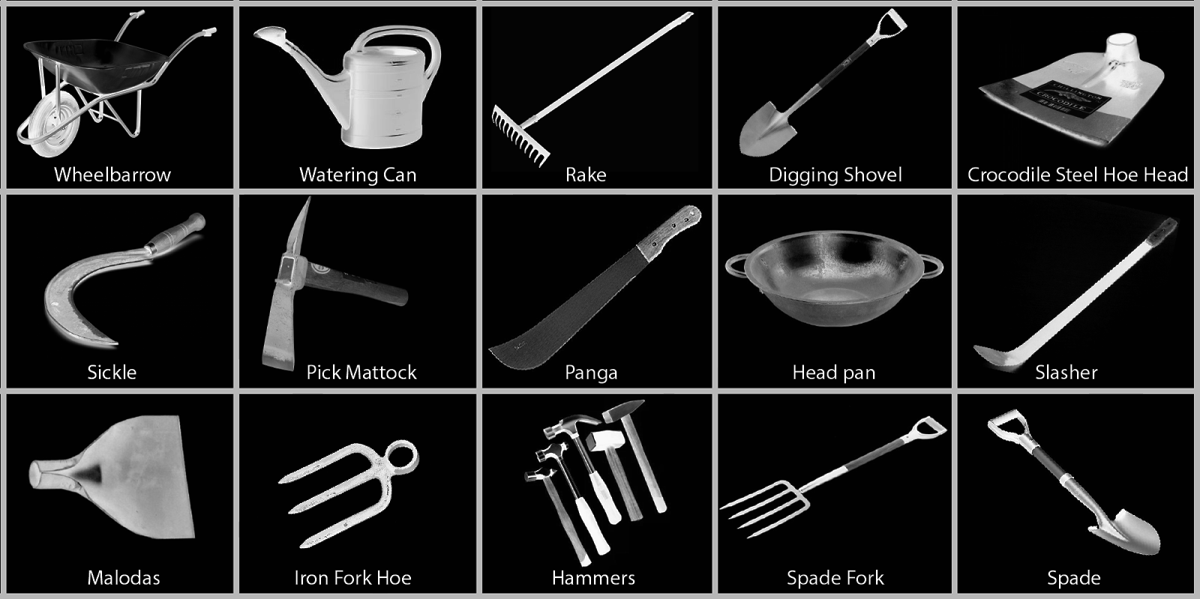

BENEFITS
STABLE INCOME
PROVIDING EQUIPMENT

Slide 6


PROVIDING DAILY WAGES
FARMER

